Slide 1
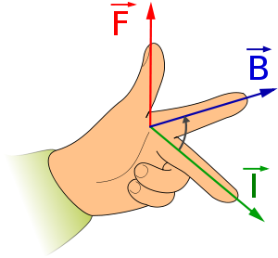
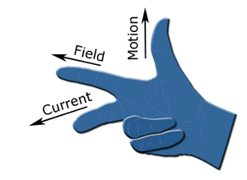
Fleming's left-hand rule for motors
Fleming's left-hand rule is used for electric motors, while Fleming's right-hand rule is used for electric generators.
Separate hands need to be used for motors and generators because of the differences between cause and effect.
In an electric motor, the electric current and magnet field exist (which are the causes), and they lead to the force that creates the motion (which is the effect), and so the left hand rule is used. In an electric generator, the motion and magnetic field exist (causes), and they lead to the creation of the electric current (effect), and so the right hand rule is used.

Slide 2
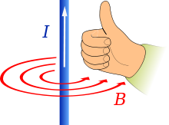
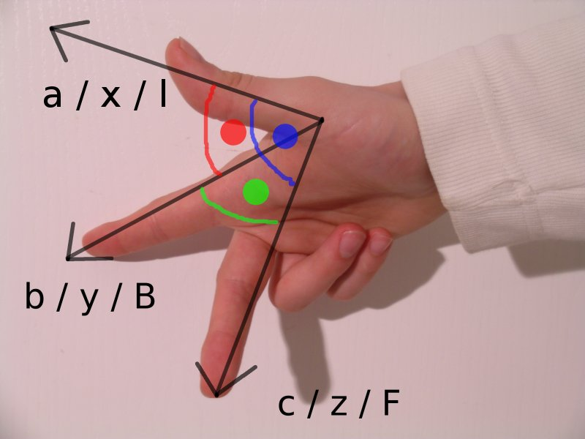
Fleming's left-hand rule for motors

